Slide 1

North Western University
Introduce to computer networking using NS2 based on the domain as www. Twitter.com
Course Code: CSE-3204
Course Title : Computer Network Sessional
Date of Submission : 24/12/2022
Slide no1

Slide 2



Team member Details
Khadaker Istekharul Haque
ID : 20201125010
Department of CSE
North western University
Jaba Baidya
ID: 20201132020
Department of CES
North Western University
Nishat Yeasmin Arzu
ID: 20201149010
Department of CSE
North Western University
Slide no 2

Slide 3
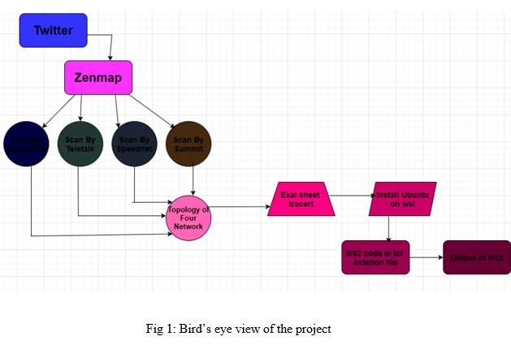
Over view the project
This project presents the theoretical practical analysis of routing IP.
We try to find a website details information about IP address ,protocols and services.
Slide no 3

Slide 4
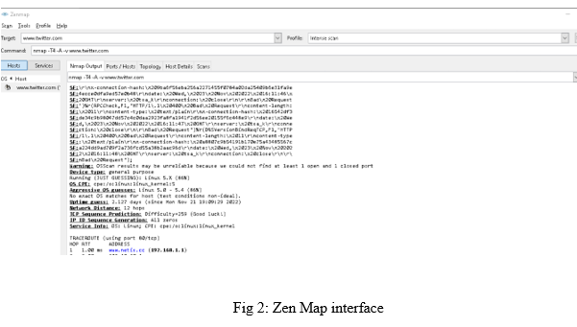
Introduction to Zenmap
Zenmap is a graphical user interface for the Nmap.
It keeps track of scans until deleted.
It command profiles make it easy to run same scan more than once.
Slide no 4

Slide 5
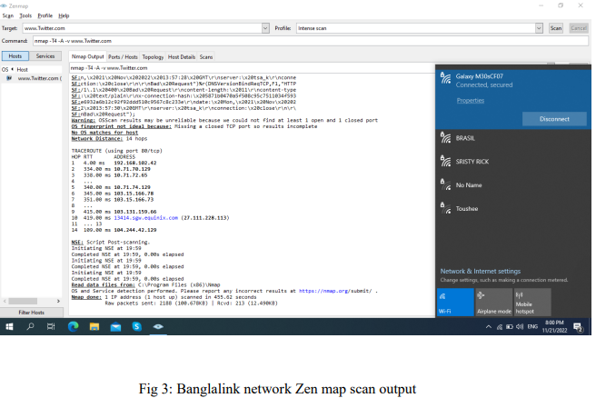
Four different source to domain
Figure 3 is the Banglalink cellular network output.
We can see there is 9 different IP address.
Slide no 5

Slide 6
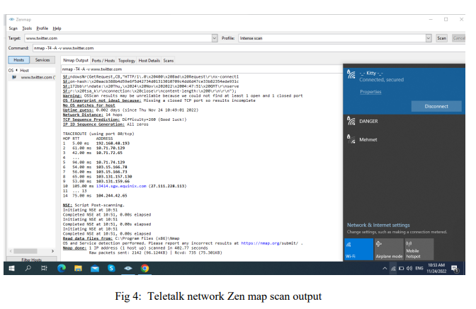
Figure 4 is the Teletalk cellular network output.
We can see there is 10 different IP address.
`
Slide no 6

Slide 7
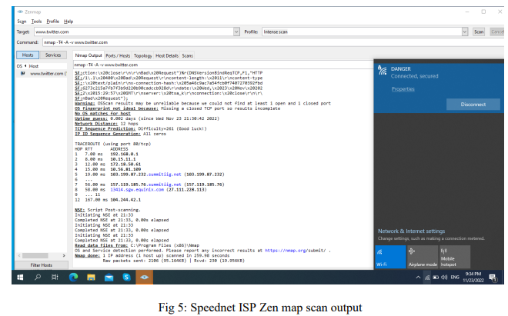
Figure 5 is the Speednet ISP network output.
We can see there is 8 different IP address.
Slide no 7

Slide 8
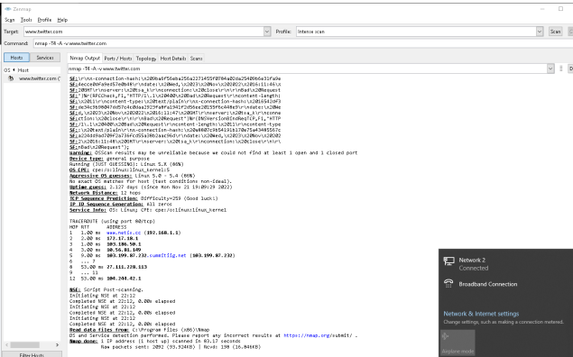
Figure 6 is the Summit ISP network output.
We can see there is 7 different IP address.
Fig 6: Summit ISP zenmap scan output
Slide no 8

Slide 9
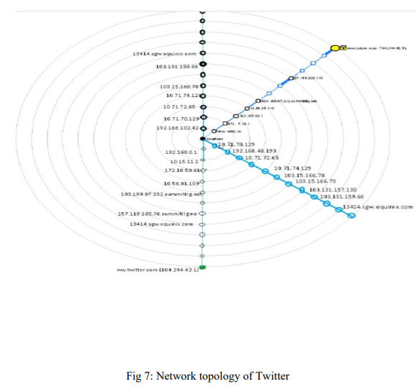
Design network topology
Fig 7 is the network topology of Twitter.
Here we can see that host IP address are different but the target IP address are same.
Slide no 9

Slide 10
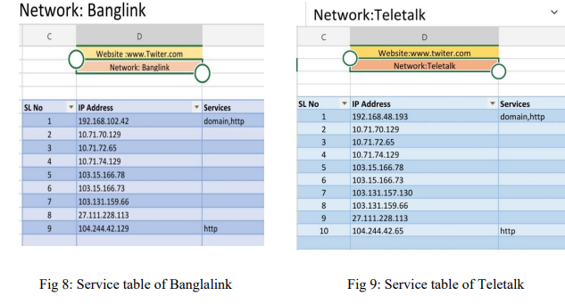
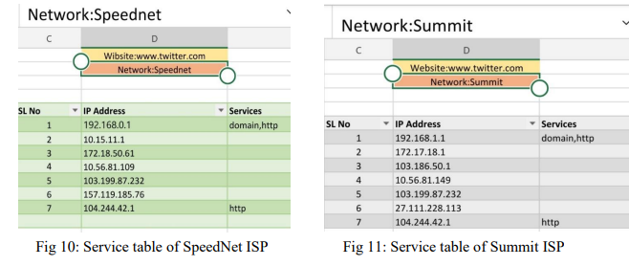
Prepare excel sheet for network diagram
After Creating network topology by Zen map now we have to ready a excel sheet for simulation.
These four figures are the serial wise Ip address table.
We get this information from Zen map by scanning Twitter.
Slide no 10

Slide 11
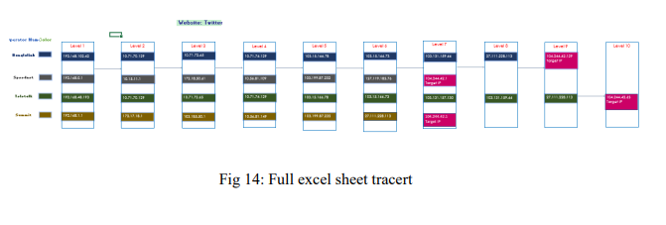
In this figure we can see a excel tracert for visualize the simulation process.
Slide no 11

Slide 12
Introduction to NS2
Network Simulator 2 (NS2) provides substantial support for simulation of different protocols over wired and wireless networks.
NS-2 can be used to implement network protocols such as TCP and UDP,traffic source behavior such as FTP, Telnet, Web, CBR, and VBR.
Slide no 12

Slide 13
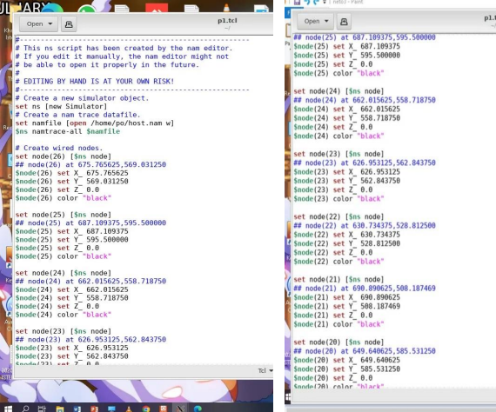
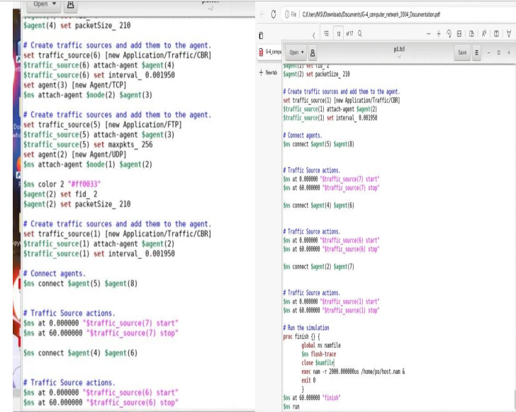
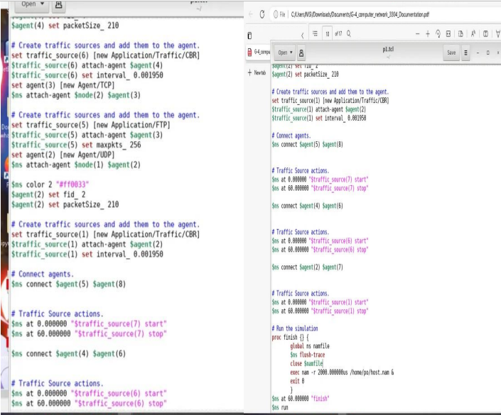
Source code of NS2
In this slide the source code of NS2 are edit and store in TCL extension file.
Fig 15: Source code of NS2
Slide no 13

Slide 14
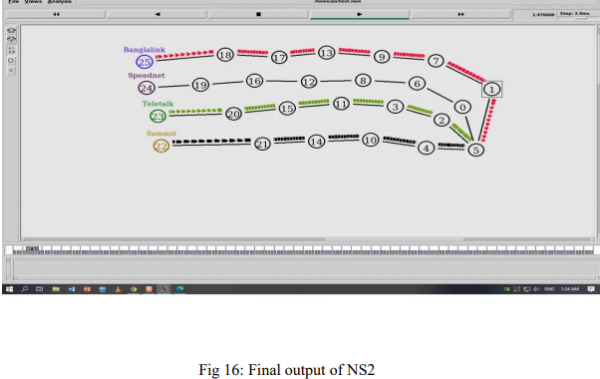
Output topology of NS2
In this slide we can see that the data packets are going to the target point.
Slide of 14

Slide 15
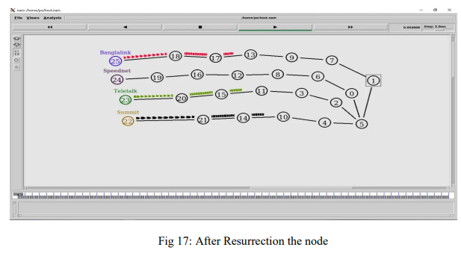
Summarization of the designed network
In this slide we can see the packet node these are going to the target point and the view of output.
Slide no 15

Slide 16
Conclusion
In this project we can learning the basic operation of NS2.We can learn that how it works . We also learn that zenmap, xming ,NS2 excel .It is also good experience to work Ubunto.
Slide no 16

Slide 17
Thank You Sir

